Slide 1


Online Assessment Reporting System (OARS)
Implementation Information

Slide 2

What is OARS?
OARS facilitates the collection, reporting, and analysis of assessments by individual student(s), teacher, grade level, school or district.
It helps school districts meet the requirements of the Common Core Standards legislation by making assessment results readily available and online.
Teachers are able to modify instruction based on assessment results. School and district administrators can plan appropriate professional development and support.

Slide 3
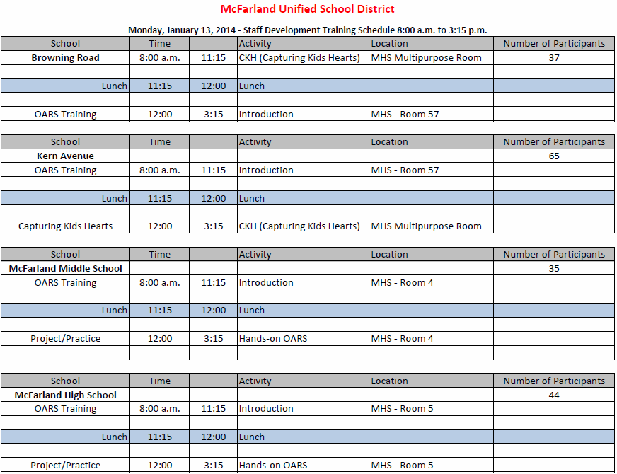

Slide 4
OARS Professional Development Plan
Beginning Level
2.Intermediate Level
3. Advanced Level
4. Expert Level

Slide 5

Running Reports
Student Information Demographic Data
Student ID
Last Name
First Name
Teacher
Section
Course Name
Department
Instructional Program
Language Proficiency
EL Level
Special Ed 1
Special Ed 2
GATE
Gender
Ethnicity
Migrant
Speech
Grade

Slide 6
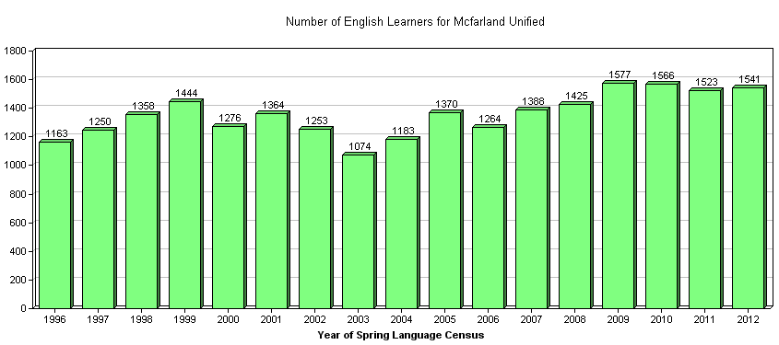
McFarland Unified School District Number of English Learners 2012 = 1,541

Slide 7





