Slide 1



Slide 2

Why an Ag Career Academy?
To prepare high school students for high-skilled jobs that earn family-sustaining salaries and benefits
To address the skills gap between market demand and workforce
We know…
1 out of every 5 jobs in the Central Valley is in agriculture, either directly or indirectly
Unemployment rates by county: 12.5% in Fresno, 10.7% in Kern, 12.8% in Kings (December 2013)

Slide 3
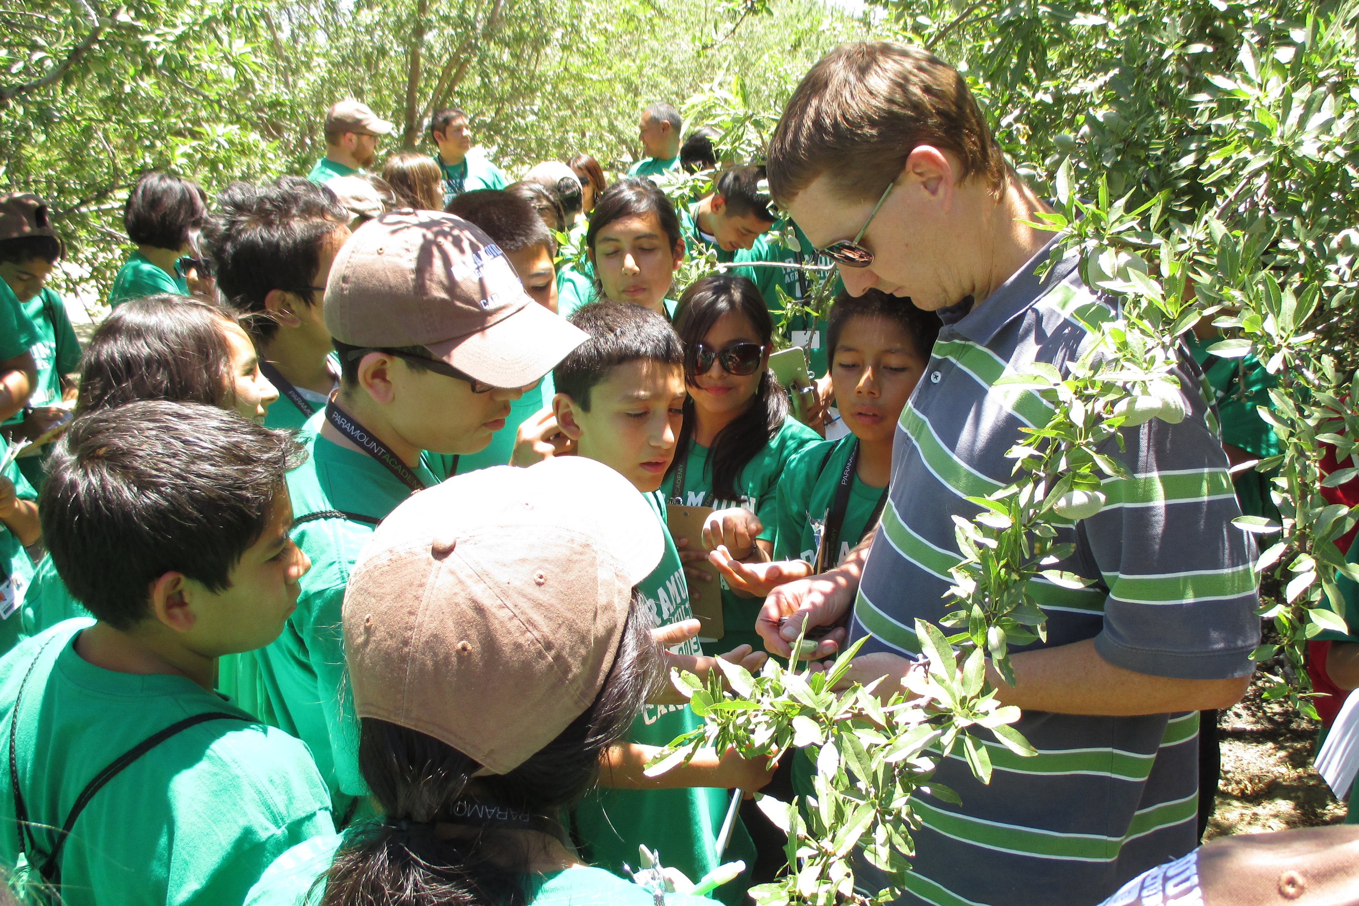
Why join the Academy?
Get hands-on work exposure in Ag classes throughout high school
Graduate with a technical certificate or associates degree in Ag

Slide 4
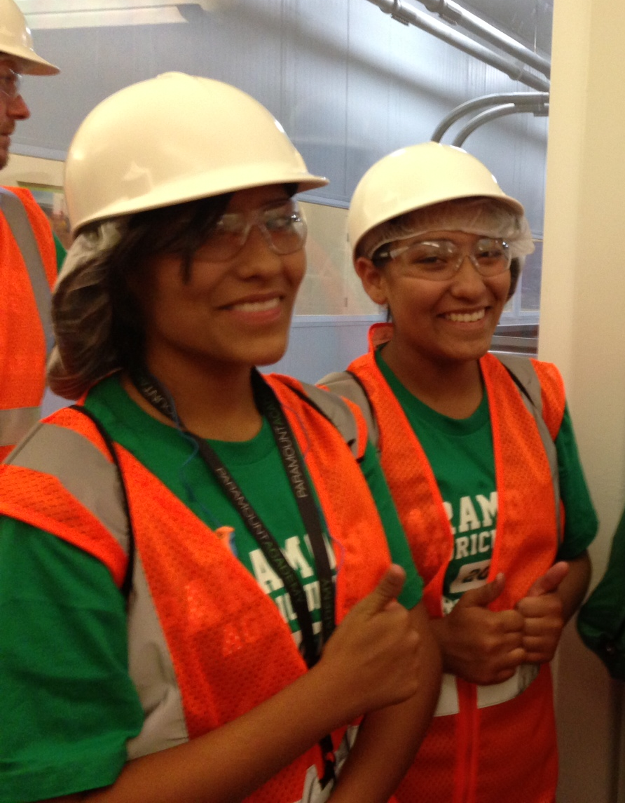
Why join the Academy?
Each student will…
Work as a paid apprentice in 12th grade
Earn college credits in 9th grade without paying college tuition
Take up to 17 college classes in high school

Slide 5
Ready for work?
Academy students will get training to become:
Machine or Equipment Operators
Technicians
Pest Control Field Scouts
General Administrators
Maintenance Managers or Product Line Supervisors
Go to a University and finish early, while saving money!

Slide 6
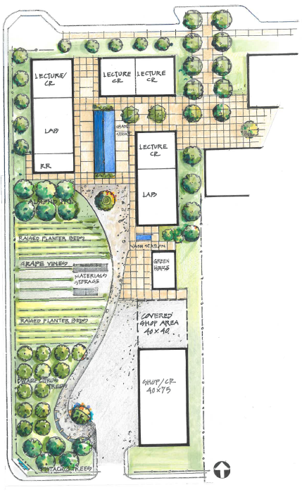
What makes us unique?
Renovated school facilities: labs, equipment, orchards
Dedicated team of high school teachers and college professors
Intervention and wraparound support services

Slide 7
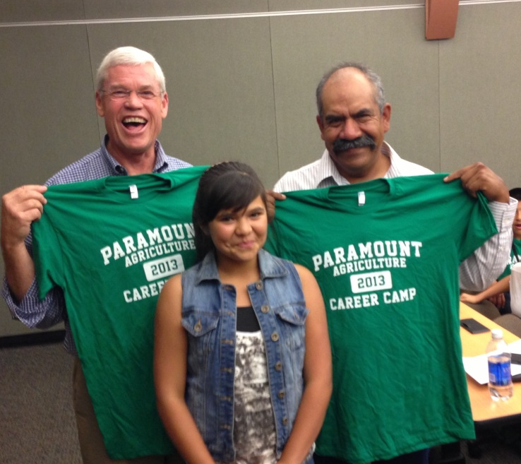
What makes us unique?
Summer camp opportunities
Overnight leadership and science camp at Yosemite
Guest speakers, job shadowing and mentoring

Slide 8





Who will the Academy serve?
In 2014, we will launch the Academy with 250 9th graders from:
Paramount Academy
Avenal HS
McFarland HS
Sanger HS
In 2015, we hope to add Wasco HS.
By 2018, we project to serve almost 1,200 students in grades 9–12.

Slide 9

What classes are required for a 2-year college degree?

Slide 10

Grade | Plant Science Certificate and/or Associate Degree | #
9 | College Success; Health & Hygiene; Computer | 3
10 | Soils; California Water; Physical Education | 3
11 | Plant Science; Weeds & Poisonous Plants; Tractor Operation; History of U.S. | 4
12 | Apprenticeship; Pest Management; Irrigation; Ag Economics; American Government; Art Appreciation; Elements of Communication | 7
Post-HS | English 1A; Math 25; Chemistry 2A | 3

Slide 11
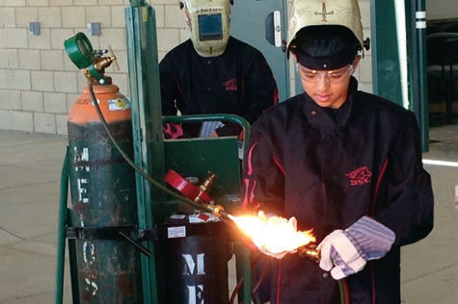
What is an apprenticeship?
A program that provides technical training for a specific job.
Academy 12th graders will work as paid apprentices for a total of 80 hours at an Agricultural Company.
Students will get real job experience.
The apprenticeships will begin in 2017 with over 130 students. By 2019 we expect to have over 250 apprentices throughout the Central Valley.

Slide 12
What outcomes do we expect?
By the end of 12th grade we expect…
90% will graduate from high school
75% will complete an apprenticeship
75% will earn a technical certificate
40% will earn an associate degree within 6 months after graduation
40% will enroll full-time in a 4-year college directly after graduation
40% will get a job in agriculture, with the option to go to college

Slide 13
What jobs are available
with a 2-year degree?

Slide 14
Earn $30K-$40K a year!
Major | Career
Plant Science | General Administrator, Pest Control Field Scout, Crop or Spray Technician, Assistant Technician, Analyst, Coordinator, Manager-In-Training
Mechanics | Equipment Operator, Machine Operator, Plumber, Electrician, Welder, Mechanic, Packing Technician
Business Management | General Administrator, Accountant, Procurement, Planner, Clerk, Manager-In-Training; Supervisor

Slide 15
What jobs are available
with a 4-year degree?

Slide 16
Fast track your career!
Major | Career | University | Years
Business | Accounting Ag Business Farming Manager | CSUB Cal Poly SLO or Pomona Fresno State | 2
Plant Science | Pest Control Advisor Farming Supervisor | UC Davis; Fresno State Cal Poly SLO or Pomona | 2
Education | Ag Teacher | UC Davis Cal Poly SLO or Pomona Fresno State | 2
Engineering | Electrical Engineer Mechanical Engineer Industrial Engineer | UC Davis Cal Poly SLO Fresno State | 3

Slide 17
Want to learn more?
For more information contact:
Eric Barba, Senior Director of College and Career Partnerships
ebarba@roll.com or 310-945-8595

