Slide 1
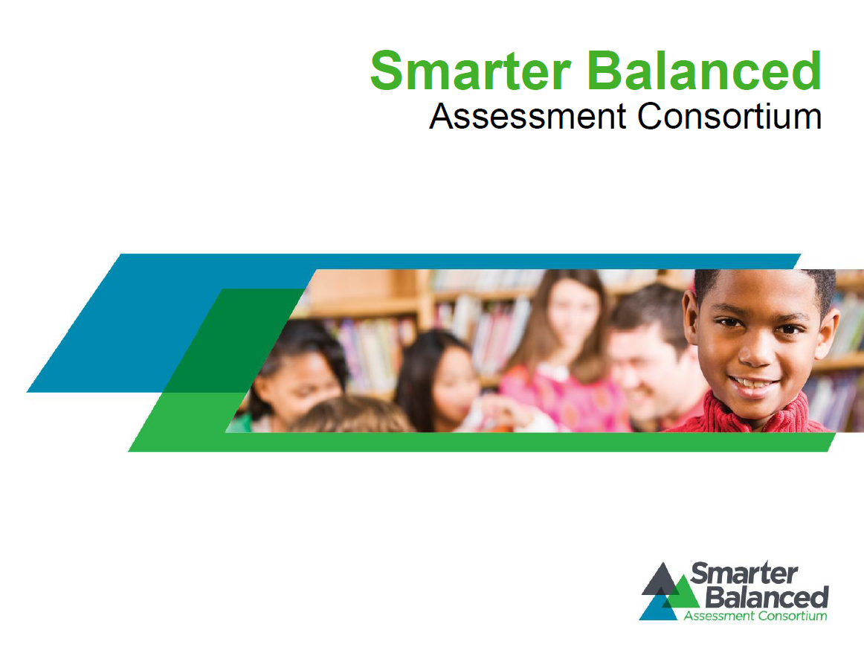

Slide 2
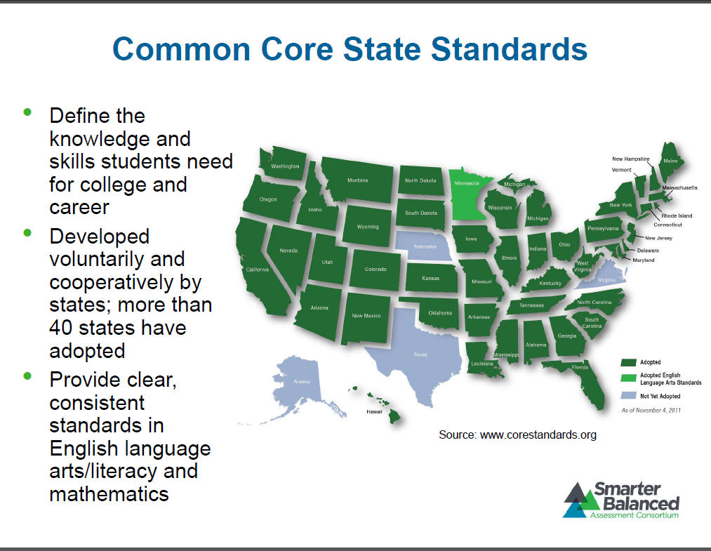

Slide 3
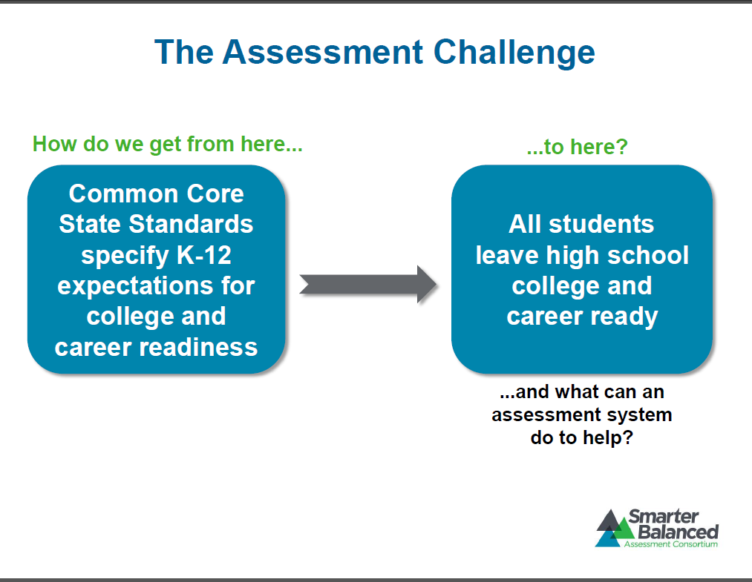

Slide 4
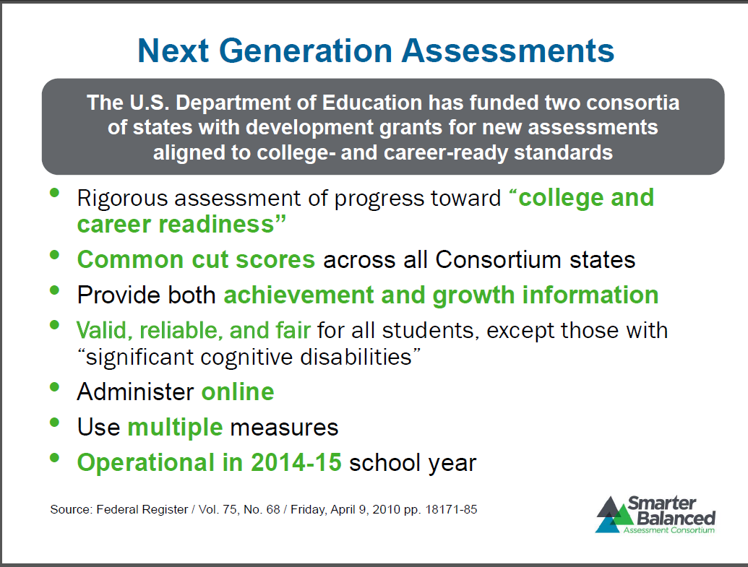

Slide 5
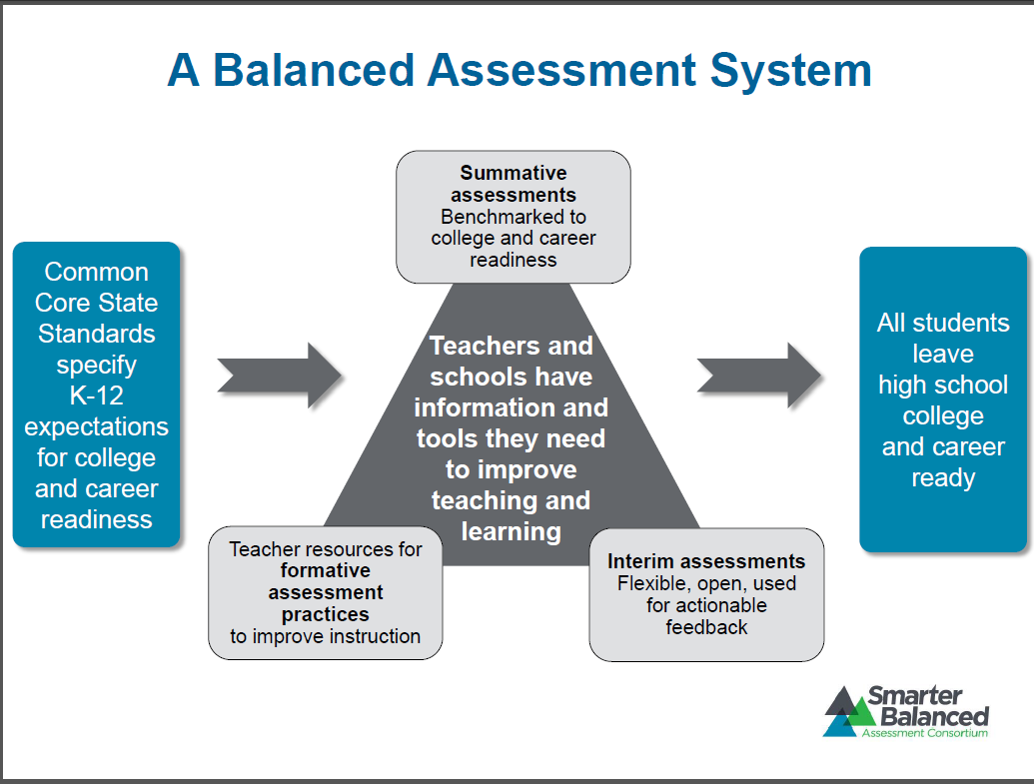

Slide 6
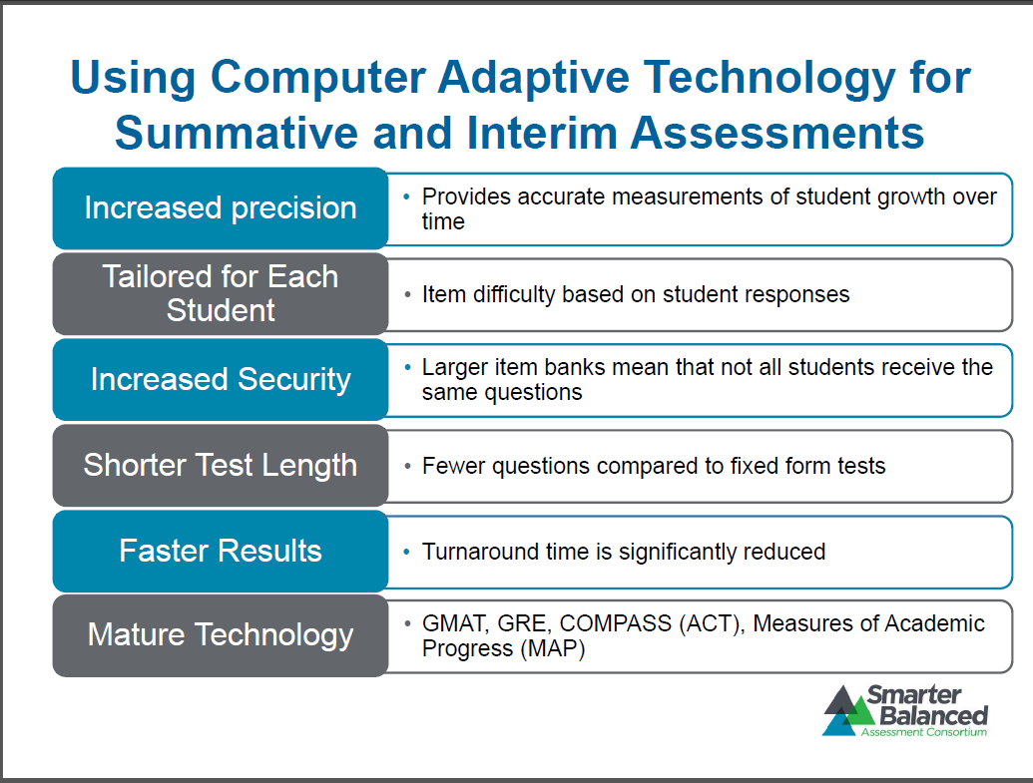

Slide 7
Computer Adaptive Testing
Based on student responses, the computer program adjusts the difficulty of questions throughout the assessment. For example, a student who answers a question correctly will receive a more challenging item, while an incorrect answer generates an easier question. By adapting to the student as the assessment is taking place, these assessments present an individually tailored set of questions to each student and can quickly identify which skills students have mastered.

Slide 8
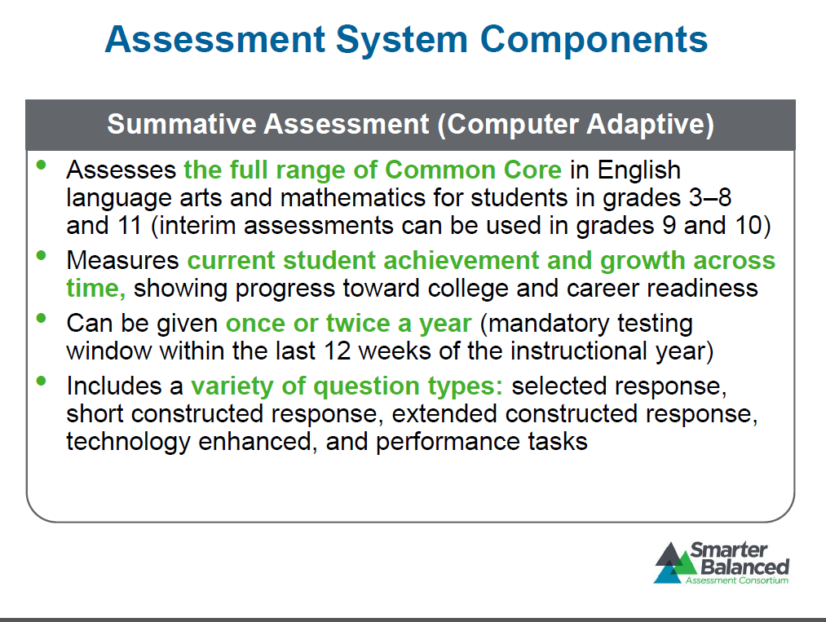

Slide 9
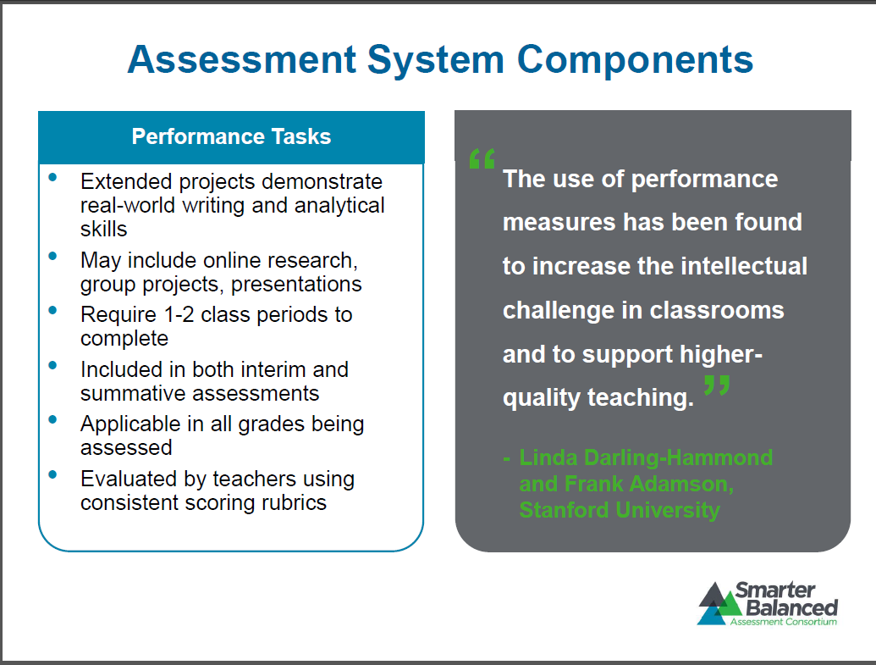

Slide 10
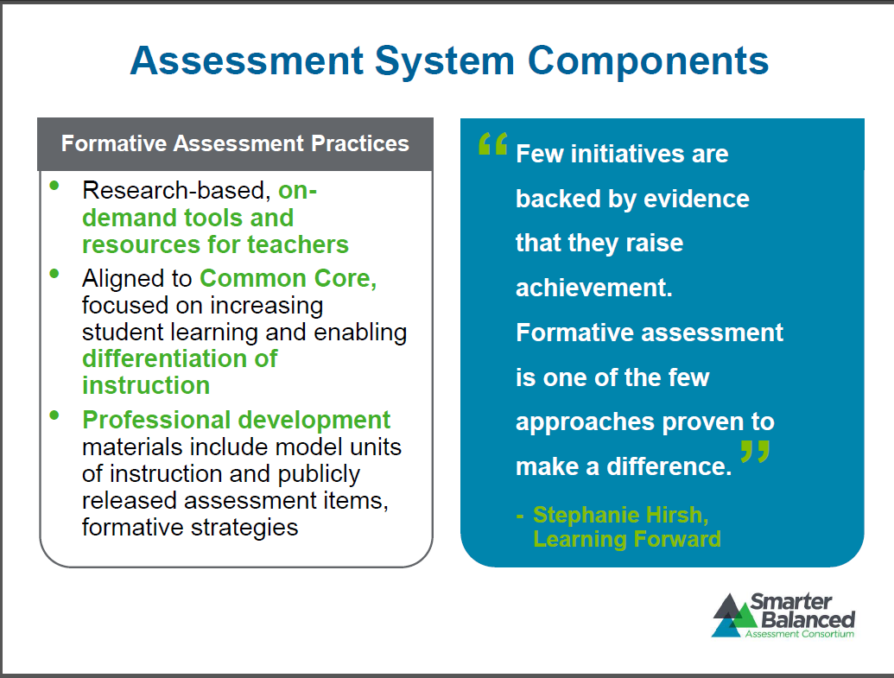

Slide 11
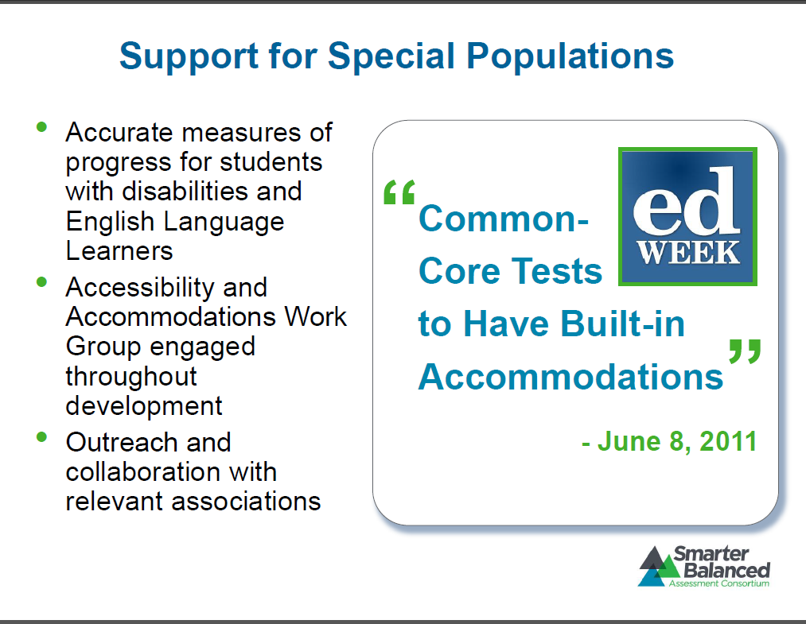

Slide 12
January
Technology installed at High School and Learning Center to accommodate testing
February
Technology installed at Middle School and Browning. Technology ordered for Kern Avenue.
March
Technology installed at Kern and installation finished at Browning and Middle.
April
Practice tests and performance testing of technology at sites.
May
Smarter Balanced tests are administered to students.
Technology Timeline
Testing Timeline
February
Smarter balance testing accounts sent from state. Testing system checked.
March
Testing Coordinator accounts created and distributed. Accommodations input for students
April
Test Administrator accounts created.
May
Smarter Balanced tests are administered to students.

Slide 13
Practice and Training Tests
The Smarter Balanced Practice Test and the new Training Test provide students with an early look at sets of assessment questions aligned to the Common Core for grades 3-8 and 11 in both English language arts/literacy and mathematics. Both resources will help teachers and students prepare for the spring 2014 Smarter Balanced Field Test.

Slide 14
Field Test
The Smarter Balanced Field Test will take place from March 18 – June 6, 2014. The Field Test is a trial run of the assessment system that helps ensure the assessments are valid, reliable, and fair for all students. It also gives teachers and schools a chance to gauge their readiness in advance of the first operational assessment in spring 2015.

Slide 15
